Slide 1

Diffie - Hellman
30.<number>
Copyright © The McGraw-Hill Companies, Inc. Permission required for reproduction or display.

Slide 2

Note
The symmetric (shared) key in the
Diffie-Hellman protocol is
K = g^{xy} mod p.
30.<number>

Slide 3
Example 30.10
Let us give a trivial example to make the procedure clear. Our example uses small numbers, but note that in a real situation, the numbers are very large. Assume g = 7 and
p = 23. The steps are as follows:
1. Alice chooses x = 3 and calculates R₁ = 7³ mod 23 = 21.
2. Bob chooses y = 6 and calculates R₂ = 7⁶ mod 23 = 4.
3. Alice sends the number 21 to Bob.
4. Bob sends the number 4 to Alice.
5. Alice calculates the symmetric key K = 4³ mod 23 = 18.
6. Bob calculates the symmetric key K = 21⁶ mod 23 = 18.
The value of K is the same for both Alice and Bob;
g^{xy} mod p = 7¹⁸ mod 23 = 18.
30.<number>

Slide 4
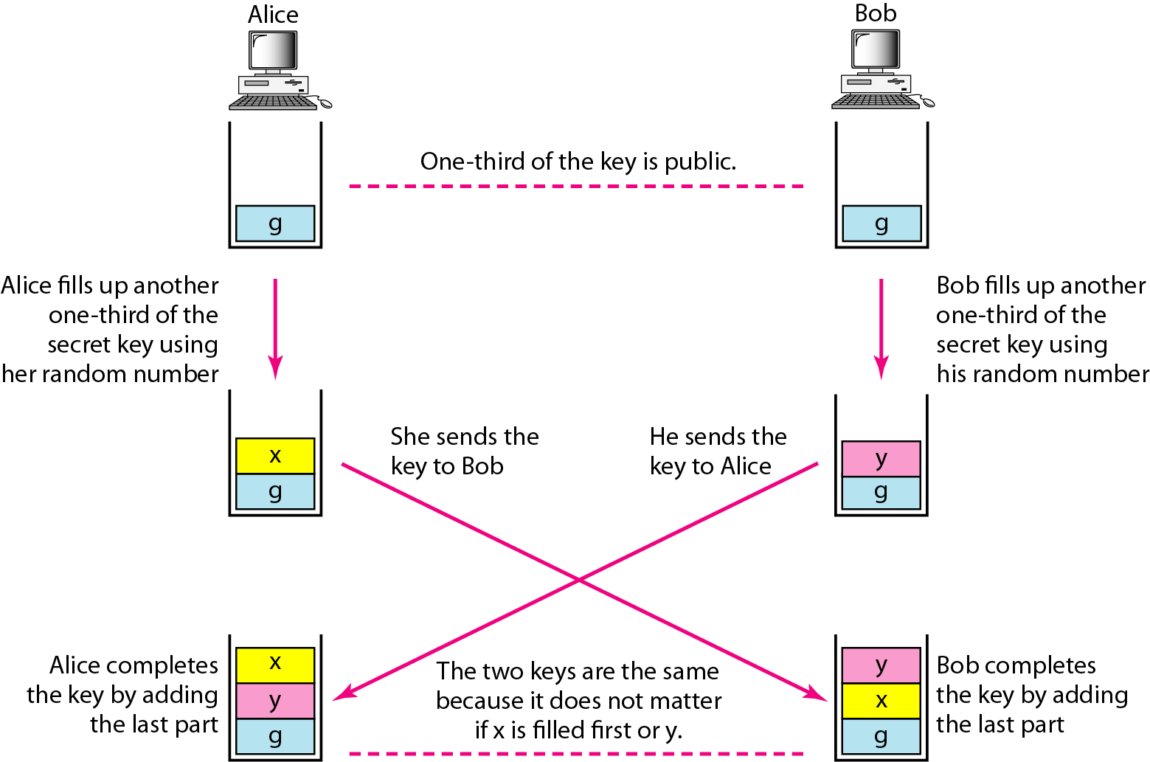
Figure 30.27 Diffie-Hellman idea
30.<number>

Slide 5
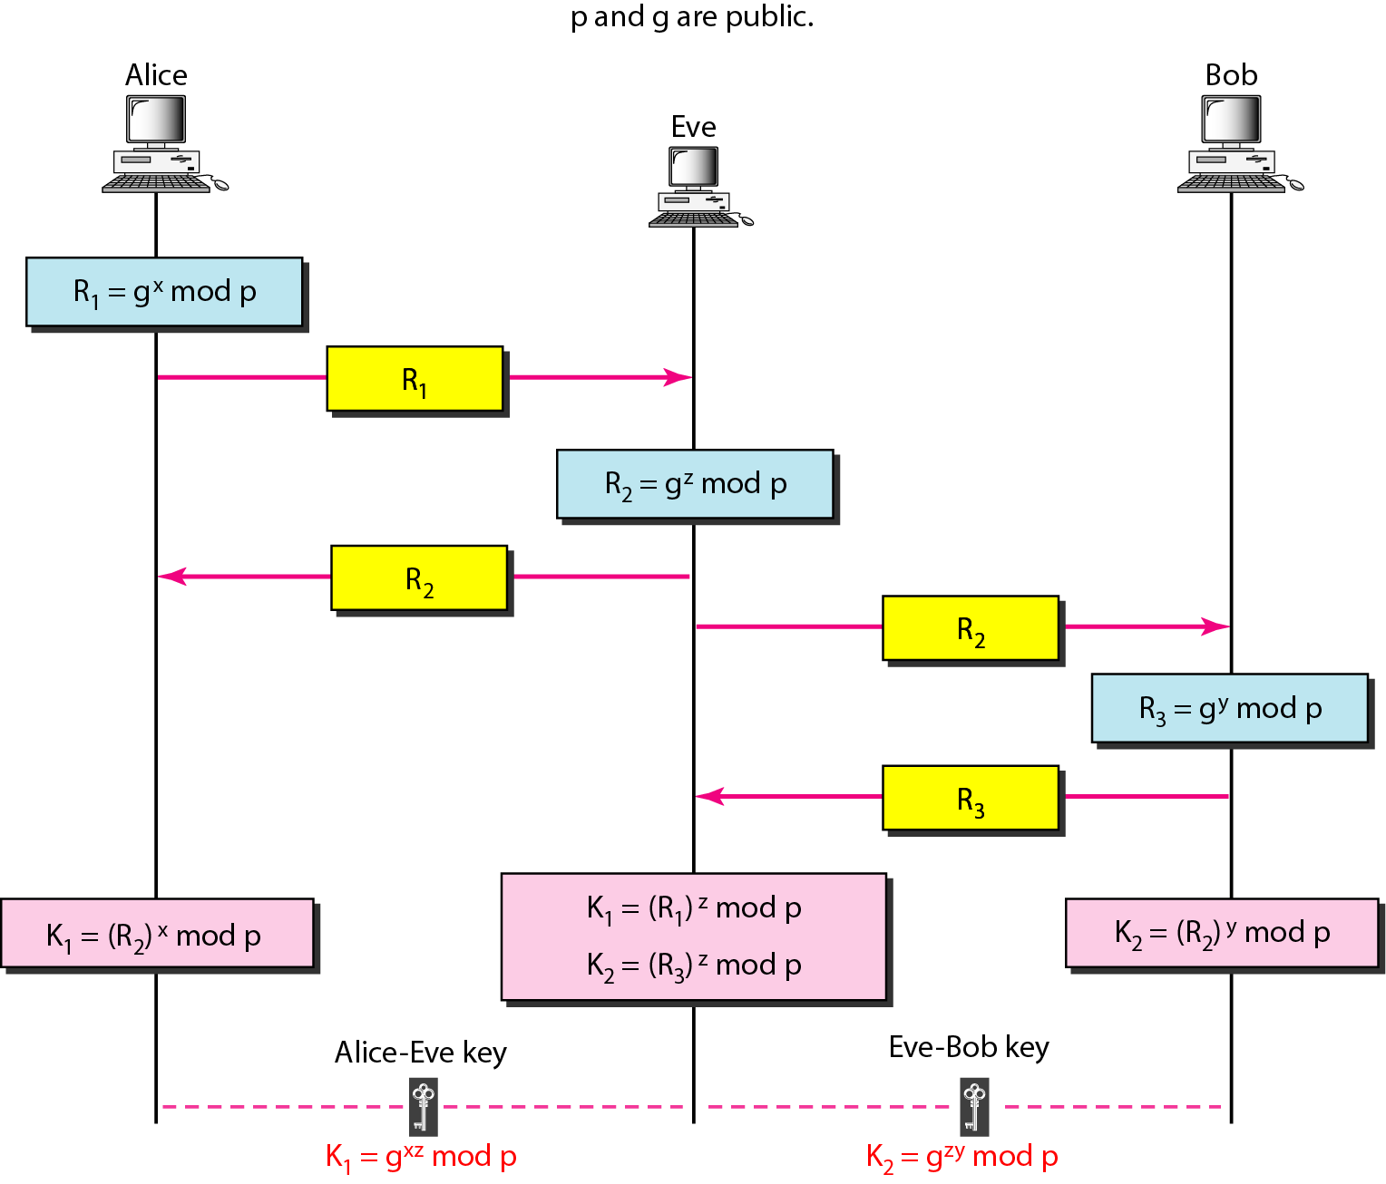
Figure 30.28 Man-in-the-middle attack
30.<number>

